Slide 1
Travel and Hospitality
Travel and Hospitality
LEVEL – LEARNER

Slide 2
Rahul Sahu (279673) / Rupa Dutt (327371)
Rahul is a Consultant in T&H Cognizant Business Consulting (CBC), while Rupa is a manager consulting in the T&H CBC industry. T&H L0/PPT/June 2012/ Version 1

Slide 3
Objectives
After completing this course, you will be able to:
Recognise the Travel and Hospitality (T&H) industry structure.
Identify the different components in the industry.
Recognise the operations of T&H service providers.
Recognise and Identify organizations in the industry.

Slide 4
Do You Know
The T&H industry forms a third of all global e-commerce activity and has an annual online sales of almost $100 billion (Source: McKinsey 2012)
Germany (72.3m), US(61.4), and UK(58.6) have the most international departures (Source: World Bank 2009)
Travel and Tourism is America’s largest services export industry. Some of their values are:
$152.4 billion in travel exports (including traveler spending in the U.S. and international passenger fare payments to U.S. carriers) and the...
$110.5 billion in travel imports (including U.S. resident spending abroad and international passenger fares paid to foreign carriers) creates...
$42 billion in balance of travel trade surplus for the U.S. (Source: ustravel.org 2012)
Notes:
Source: McKinsey Quarterly

Slide 5
Overview of T&H Industry

Slide 6
Context Setting: Overview
Travel and Hospitality (T&H) is one of the world's largest and fastest growing industry. Travel has evolved over time. Not only have there been developments in the products and services provided, but the reason for travel has also evolved.

Slide 7
Objectives
After completing this chapter, you will be able to:
Explain the structure of the Travel and Hospitality industry.
Identify Travel industry players.
Identify industry trends.
Describe the Travel planning process.

Slide 8
Travel and Hospitality
What is Travel and Tourism?
“The activities of persons travelling to and staying in places outside their usual environment for not more than one consecutive year for leisure, business, and other purposes”
World Tourism Organization 1993
Travel includes, airlines, trains, cars, bus, and so on.
Hospitality includes hotels, restaurants, theme parks, cruise, and so on.

Slide 9
Travel and Hospitality (Contd.)
Travelers can be classified as follows:
Leisure: Travel for holidays, sport, culture, spiritual, and so on.
Business: Travel for meetings, conferences, trade fairs, and so on.
Impact - There are both positive and negative impacts on the industry. Some of them are:
Social and Cultural: Conservation or preservation of historical sites, pressures on local traditions, and so on.
Economic: Generation of employment, develop local infrastructure, and so on.
Environmental: Regeneration of the environment, pollution, and so on.

Slide 10
Industry at a Glance
Growing Industry
Tourism is one of the biggest and fastest growing industries in the world.
Increase Workforce
Tourism sector is the largest employer, accounting for approximately 225 million jobs or 10.7% of the global labor force.
It is estimated to rise to 275 million by 2022.
Bright Future
Travel and Tourism’s direct contribution in 2011 was US$ 2 trillion and is expected to reach around US$10.5 trillion by 2019.
Accounts for one-third of all online sales and is expected to reach US$1.3 trillion in 2022.
4.2% of the annual average growth rate is expected over 2012-2022.
Source: WTTC, 2008-2009
Notes:
Source: world tourism council report 2012
MckInsey Report

Slide 11
Industry Landscape
Trends
Demand for tourism
Impact on price or profitability
Exchange rate
Increased taxation
New and emerging markets
Oil price
Holiday booking via new technology
Increase in domestic tourism
Increase in package holidays
Surge in environmental awareness
Emerging markets
Technology advancements
Social media
Mobile communication
The industry will take up to 2016 to recover from the economic meltdown.
Hotels sector suffered the most with heavy discounting and falling sales.
Notes:
Technology trend
Social media is seen as more important than pay per click advertising
Consumers are reluctant to use mobile
Travel industry quite advanced in using social media
Emerging Markets:
BRICS – Brazil, Russia, India, China,
SLIMMA – Sri Lanka, Indonesia, Malaysia, Mexico, Argentina

Slide 12
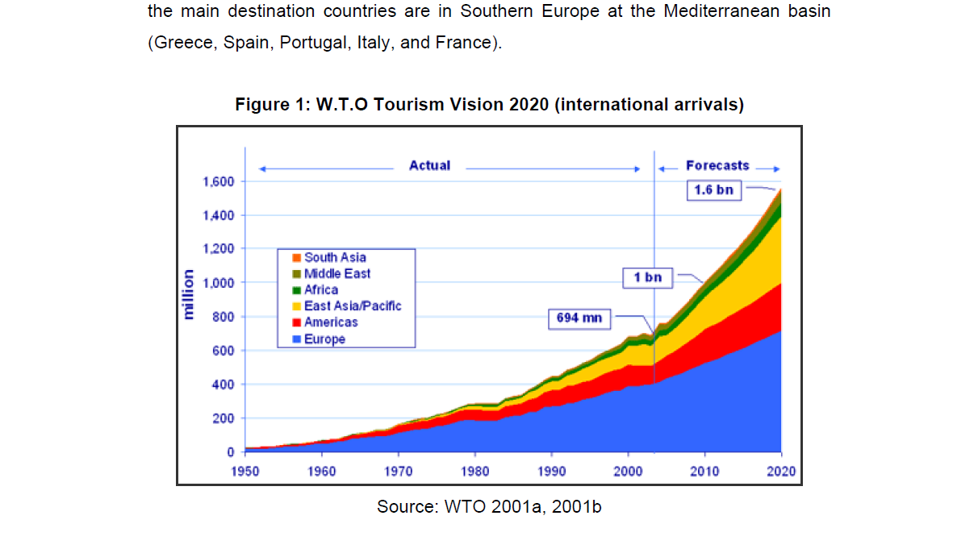
World Tourism

Slide 13
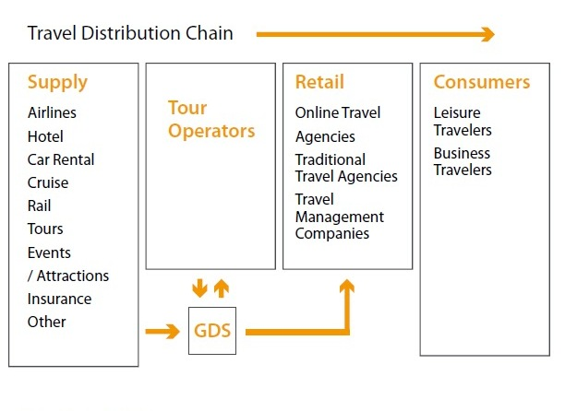
Travel Industry Players
The components of the travel and hospitality business from supply to demand are listed below.
Restaurants
Distribution refers to the mechanism by which suppliers are able to market and sell their products to consumers. Distribution traditionally occurs via the Global Distribution Systems (GDS) and at present also the internet.

Slide 14
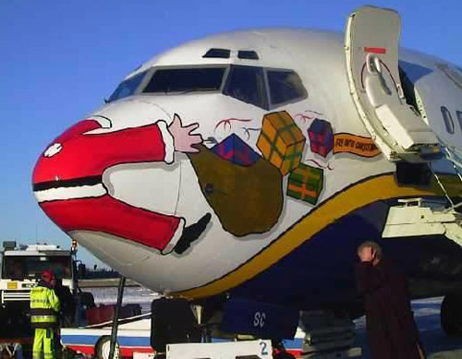


Types of Travelers
51%
27%
15%
Leisure, recreation, and holidays
VFR, health, religion, and others
Business and
Professional
Less likely to purchase premium service
Price sensitive
Strongly co-related to economic conditions
Medical tourists are price sensitive but are impervious to economic uncertainty
Need special care and end-to-end arrangements
Stays for longer period of time
Religious tourism peaks at certain times of the year
Visiting friends and relatives (VFR) peaks during the holiday season
Travel several times a year
Tend to purchase upgraded services with higher margin
Corporations negotiate volume discounts
Importance given to expense management and reporting
% of total tourism in 2011 Source: UNWTO 2011

Slide 15
Travel Planning
Dream
Tourist Boards
Print Media
Search
Friends
Book
Travel Agent
Airline
Share
Experience
Visual Media
Advertisement
Travel Agent
Travel Guide books
Hotel
Actual Travel
Photo albums
Videos
In the last decade
Online Price Review
Kayak, Google
Trip Advisor, Facebook
Online
Booking
Expedia, Travelocity
Brand website
Experience and Sharing
Mobile device allow instant sharing
Facebook 4Square Gowalla
Advent of the www has changed the way people plan and experience travel.
Notes:
85% of leisure travelers consider the internet their main source of planning travel
Over 50% travelers use mobile phone or device for travel related information

Slide 16
Travel and Hospitality Environment
Future of travel has been shaped by technological and social innovations, and impacting suppliers, intermediaries, and consumers. Some features are:
Early adoption of the internet led to a shift in how business is conducted, and the rise of online TAs.
Today, the T&H sales over the web is one-third of all e-commerce activity.
Cost of distribution is reduced, and the emphasis is on direct connect.
Pressure is on the industry to change legacy systems, and to distribute across multiple channels.
Sales are accomplished through new offerings like Dynamic Packaging, identifying and rewarding the most loyal customer, and Revenue Management.
Advent of low cost carriers hit the existing big players.
Adoption of emerging standards - Open Travel Alliance (OTA) compliant XML schemas.

Slide 17
Travel and Hospitality Environment (Contd.)
Growing customer demands are met by providing more options for content and price. A one-stop-shop to address all the needs, and a consistent view across all channels.
The customer are empowered by web presence, self service device, mobile device, and tailored offers based on customer history.
Customer analytics and engagement have become the key for survival.
Customers not only shop and buy online but also share their experiences.

Slide 18
New Trends
Some of the new trends that are followed today are:
Mobile applications:
Gaining access to consumers anywhere
Texting orders by consumers beforehand
Receiving discounts at point of purchase
Bypassing servers
Paying bills directly
Leveraging social media:
Turning fans into buyers and ambassadors
Advertising
Transparency:
Disclosing nutrition mix and sourcing
open kitchens
Sanitation grade
Integrating Franchise Management system
Enterprise Asset Management and Point Of Sales

Slide 19
Summary
Some key points covered in this chapter are:
Key players in the Travel Industry are Travel Agents and intermediaries, Hotels and Restaurants, Airlines and other transport providers. They are known as suppliers.
The travel planning process consists of: Dream, Search, Book, Experience, and Share.
Advances in technology have created new trends in the industry such as online booking, remote check-in, virtual sharing of holiday or travel experiences.

Slide 20
Travel Agent

Slide 21
Context Setting: Overview
Travel Agents (TA) have been the most critical component of the T&H industry; intermediating between supply and demand enabling travel and holidays for the consumer.

Slide 22
Objectives
After completing this chapter, you will be able to:
Identify the different types of TAs.
Identify the business models of Online Travel Agents (OTA).
Identify leading industry players.

Slide 23
Travel Agents
TAs provide tourism related services to the customer on behalf of suppliers such as airlines, hotels, car rentals, cruise lines, railways, package tours, and so on. Travel Agents can be categorized into the following two types:
Traditional Travel Agent
Conducts business via brick and mortar presence.
Online Travel Agent
Have online presence as well mostly.
Conducts business online.
Does not have a brick and mortar presence.
Customer contact point is via website.
Customer contact point is via their offices or website.
New distribution channel for suppliers.

Slide 24
Types of Travel Agents
The different kinds of TAs are:
Travel Management Company
Manages travel for corporate on negotiated contracts
Provides expense management and reporting
Some examples are Amex, Hogg Robinson Group (HRG), Carlson Wagonlit Travels (CWT), and BCD Travels
General Sales Agent
Typically are representatives for an airline in a specific region
Sells all products of the airline
Sells, in some cases, products of more than one airline
Sells other travel products as well sometimes
For example, hotels, tours, and so on

Slide 25
Types of Travel Agents (Contd.)
Tour Operators
Combines different tour and travel components to create a holiday
Prepares itinerary
Typically includes, travel, accommodation, travel services
Some examples are Cosmos and Kuoni
Wholesaler or Merchant Agent
Provides travel program, and tour and travel services to retail agents
Does not sell directly to the public
An example is Gullivers (GTA)
Online Travel Agent
Conducts business online
A mainstream distribution channel for many parts of the travel industry
Some examples are Expedia and MakeMyTrip

Slide 26
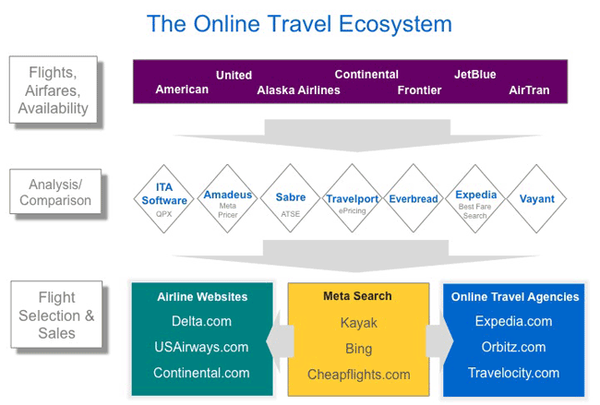
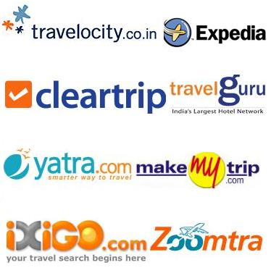
Online Travel Agent
OTAs have greatly improved the travel shopping experience and convenience for consumers with increased pricing transparency, shopping convenience, and relevance of content.
They have made significant contributions to hotel search result displays and sorting options making it easier for travelers to compare options from hundreds of possible results.

Slide 27
OTA Sales
The advent of the internet and subsequently the OTAs or Internet Distribution Systems resulted in innovations in how travel products are sold. They are:
Opaque fares: Opaque fares allow travelers to get deeply discounted plane tickets. Airline and exact departure times are hidden until the flight ticket is purchased, and travelers do not get loyalty points. For example Priceline’s Name Your Own Price airfare bidding model.
Dynamic packaging: Debuted by Expedia, now standard throughout online travel, this book together and save option allow travelers to shop for multiple components, such as Flight + Hotel, in a single search.
Flexible and alternative date search: This allows travelers to compare flight options across multiple departure times and return dates to find the lowest possible fare.
Alternative airport search: Travelers can search across multiple departure and arrival airports within an acceptable distance to find the lowest possible fare or most convenient schedule.
Low-fare notifications: OTAs introduced a feature that would e-mail customers about specific deals on particular O&D (origin and destination) pairs.
Notes:
Online sales of leisure and unmanaged business travel in the U.S. surged from just $6.5 billion in 1991 to more than $95 billion in 2008
More than nine of ten U.S. travelers used the Internet at some point in the travel planning process in 2008
Four largest OTAs: Expedia, Orbitz Worldwide, Priceline, Travelocity and their affiliated sites, represented some 96% of all online travel agency sales in 2008.

Slide 28
Revenue Streams for TAs
Source of revenue for a TA is the commission or fee they receive from suppliers, such as airlines, hotels, and so on, for selling their products. They also get fees from the travel management contracts they may have with corporates.
Apart from the standard business expenses, TAs also have to pay a fee to GDS to access their services.
Commission/ Fee from Suppliers
Management Fee from Corporates
$ $ $
Transaction Fee to GDS
$ $

Slide 29
Summary
The key points covered in this chapter are:
There are many types of TAs depending on the type of service they provide and the mode in which they operate.
Unlike traditional TAs, online TAs do not have a brick and mortar presence. Their business is necessarily conducted via the Internet or web.
Some well known travel agents are Amex, Thomas Cook, Kuoni, TUI, Expedia, and so on.

Slide 30
Intermediaries

Slide 31
Context Setting: Overview
Intermediaries, until the recent internet explosion, were behind the scene players in the travel industry. They have enabled seamless global travel by bringing a wide choice of T&H suppliers right to our fingertips.

Slide 32
Objectives
After completing this chapter, you will be able to:
Describe how the T&H products and services are distributed.
Identify GDS evolution and operation.
Recognize the leading intermediaries.
Recognize how intermediation works in the industry and its impact.
Define the concept of Direct Connect.

Slide 33
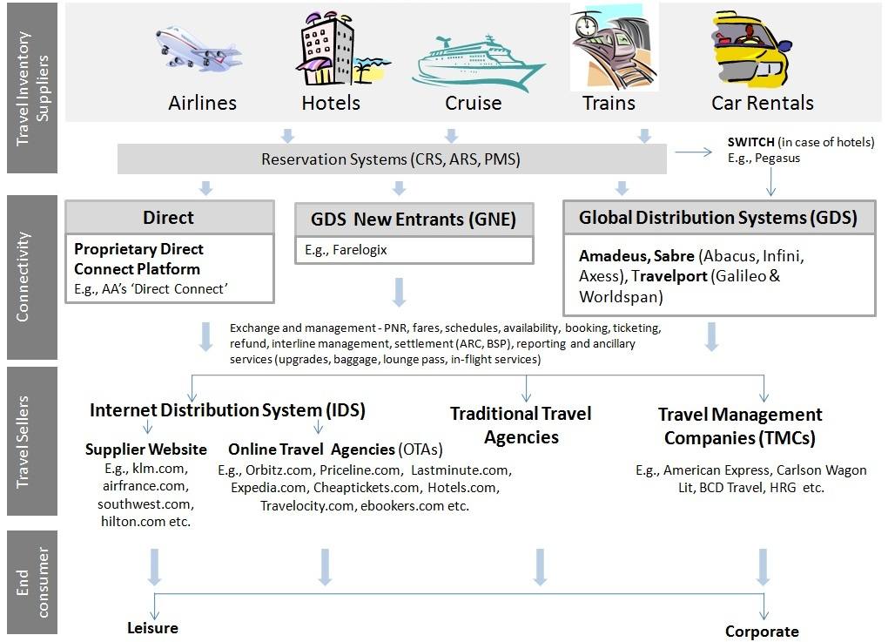
Travel Distribution
There are two types of Travel Distribution. They are:
Direct distribution: When suppliers, or owners of the product (airlines, hotels, and so on) sell their products directly to consumers, whether on the phone, in person, or over the internet.
Intermediated distribution: When a third party, such as a TA, tour operator, travel management company, or OTA, sells the travel product to the consumer on behalf of the supplier.
TAs, OTAs, and other intermediaries often access the supplier content via one of the GDSs.

Slide 34
GDS Role
The roles of GDS are as follows:
GDSs are the key technology infrastructure connecting suppliers, tour operators, and retailers. Just as travel intermediaries play a key role in travel distribution, GDSs play an important role for intermediaries.
GDSs aggregate billions of possible airfares, schedules, hotel and car rental rates, availability information, and other content. They present these options in a real-time shopping and booking environment for travel intermediaries.
GDSs also distribute tour operator and cruise lines products.
GDS provides shopping, pricing, booking, and ticketing services to the OTAs since the mid-1990s. They also provide business infrastructure to the travel agencies.

Slide 35
GDS Role (Contd.)
TAs use GDS vendors for middle and back-office tools (for example, quality control procedures and accounting), customer management and marketing software, online booking engines for leisure and corporate travel, and other functions.
GDSs enable suppliers to make their products available to consumers globally through travel agencies.
GDS are the preferred booking method of corporate Travel Agents.
GDS provides online booking tools to the corporate travel market.
GDSs are now facing increasing competition from airline websites and Internet TAs.

Slide 36
Major GDS
GDS | Stakeholders | Evolution | Market Share*
AMADEUS | Air France, Lufthansa, Iberia , Free float | Formed through a consortium of major European airlines and System One, the original CRS of Eastern Airlines. | 37%
GALILEO and WORLDSPAN | Travelport | Galileo evolved from the merger of Apollo CRS (United Airlines) and Galileo CRS (consortium of European airlines). Worldspan resulted from the merger of the TWA PARS CRS and the Delta Air Lines DATAS II. | 30%
SABRE | Delisted in 2007, privately held by Silver Lake and Texas Pacific Group | American Airlines and IBM | 28%
ABACUS | ANA, China Airlines, EVA, Garuda, Dragonair, Royal Brunei, Singapore Airlines, Malaysia Airlines, Silk Air, Cathay Pacific , SABRE (serves 20 countries in Asia, based in Singapore) | Founded in 1988 by the main airlines in Asia. It entered into an agreement with Worldspan in order to enhance its offering to travel agencies. | 5%
In addition, there are several smaller or regional GDSs including Infini (Japan), Axess (Japan), Tapas (Korea), Fantasia (South Pacific) that serve interests of specific region or countries.

Slide 37
Evolution of GDS
GDS Evolution
Reservations were extremely difficult for airlines to handle manually
The original system were developed in 1960s and used IBM Selectric typewriters as Input devices
Global Distribution System did not begin with the advent of Internet
It began as a way for Airlines to reach their best customers
Initially they were not Global but Computer Reservation Systems (CRS)
2010
2000
2006 - Negotiations with airlines to reduce distribution fees leading to 2 new pricing models^
2008 - GDS processed
More than 1.1bn transactions*
which generated $9.6bnin revenues
1990
1980
1960
1970
2002- some airlines exclusively sell online
2004- Deregulation of US GDS market
1950
Anti-discrimination rules were established in the U.S. in 1984 and in 1989 in Europe
Advent of Internet as alternate sales channel
Evolution of ARS DATAS, Delta
APOLLO, United
PARS , Trans World Airlines
1974 - GDS started with JICRS
GDS terminals installed in agent offices
GDS battle for market share
Regulation of GDS Market
1964 - SABRE was launched by American Airlines and IBM
Manual flight reservations
E -commerce in travel pre-dates the dot-com boom by some three decades and had become quite commonplace by the mid-1980s.
* Transactions for air, hotel and car rental only. Does not include rail, cruise, tour, and other transactions.
^ For US market

Slide 38
GDS: Facts and Advantages
GDS Facts
GDS Advantages
Transactions¹ | 1,104M
Revenue² | $9,624B
Travel sales | $ 268B
Travel Agency location³ | c. 163,000
Users⁴ | c.490,000
Airlines | More than 550
Hotel Properties | More than 90,000
Car Rental | More than 30,000
Access to comprehensive travel information: The GDSs function as a central hub, aggregating schedules, fares, availability and booking capability.
Mission-critical availability and response times: In the “always-on” age of the Internet, GDS infrastructure supports a tremendous volume of requests and transactions 24 hours a day, seven days a week.
Interline tickets (multi-carrier itineraries): where a traveler flies on more than one airline within the same itinerary. GDS provide shopping and pricing capability across the billions of possible flight combinations & airfares. Interline tickets are more or less unique to online and traditional travel agencies.
Data as on 2008
1. Air, hotel and car rental transactions only: data provided by Amadeus, Sabre, and Travelport
2. Amadeus revenue converted to US$ at an average exchange rate of 1.47 (Source: OANDA)
3. Assumes reduction of 7% for locations that use more than one GDS
4. Assumes approximately three agents per location

Slide 39
GDS Regulation
GDS Regulation was introduced in North America and Europe in 1980s. It was later amended in 1990s so that the airline-controlled GDSs could not discriminate against other GDSs or airlines. The main highlights of the regulation were:
Display flight and fare information in an unbiased manner: This prevented the GDSs from unfairly displaying their parent carriers’ ﬂights most prominently, given that 85 percent of tickets booked are selected from the ﬁrst screen displayed.
Provide access to their systems to all carriers on a same-price, nondiscriminatory basis: The main objective was to protect smaller carriers from higher prices, as they were already in a weaker competitive position.
Avoid imposing highly restrictive contract terms on TAs: GDSs cannot abuse their power by compelling travel management companies to sign exclusive agreements.
Provide participating carriers with available Marketing Information Data Tapes (MIDTs) on a non-discriminatory basis: This booking and marketing data covers TAs’ sales by destination, airline, and fare class. It also enables airlines to monitor demand for route planning, yield management, and marketing purposes.

Slide 40
Revenue Models of GDS
Historical
Opt in
Airlines
Airline content
TA
Commissions/
net rate
Airlines
TA
Booking transaction fee $12-14 per ticket
Booking transaction fee $6-8 per ticket
Opt in fee
$.80/segment $2/ticket
Net deals
or rebates
Net deals
or rebates
GDS
GDS
GDS inducement incentive
GDS inducement incentive
Corporate Travel Buyers
Corporate Travel Buyers
Service fees
(net of supplier commissions, subsidized by GDS inducements)
Service fees
(net of supplier commissions, inclusive of opt in)
Full Content | Yes
GDS Access Fee | No
Airline Surcharge | No
Agency Incentive | Yes
Full Content | Yes
GDS Access Fee | Yes
Airline Surcharge | No
Agency Incentive | Yes
These agreements expired in the United States on
September 1, 2006
Airlines pay significantly lower fees to the GDS, while
agencies pay a new opt-in fee in return for access to
full content.
These models are from the US market
40

Slide 41
Revenue Models of GDS (Contd.)
Surcharge Model
ARC Clearing House
Airline surcharge $3.50/ticket
Airline surcharge $7/ticket
Airlines
TA
Commissions/ net rates
Net deals or rebates
Full Content | No
GDS Access Fee | No
Airline Surcharge | Yes
Agency Incentive | Yes
GDS
Booking transaction fee $12-14 per ticket
GDS inducement incentive
Corporate Travel Buyers
Service fees
(net of supplier commissions, inclusive of airline surcharge)
This is the model is imposed by the airlines if an agency does not choose a GDS opt-in model.
Airlines impose a high fee on tickets issued by agencies and may limit content.
These models are from the US market

Slide 42
GDS owned OTAs
The major GDS companies also own OTAs. They are listed below:
GDS | Leisure Market | Corporate Market
Amadeus | Opodo | Amadeus e-travel management
Sabre | Travelocity is an OTA and wholly owned subsidiary of Sabre. Its sister site includes: Lastminute World Choice Travel Zuji | Get There Travelocity business
Travelport | Travelport holds a majority stake in Orbitz which includes: CheapTickets ebookers HotelClub RatesToGO | Traversa Orbitz for business

Slide 43
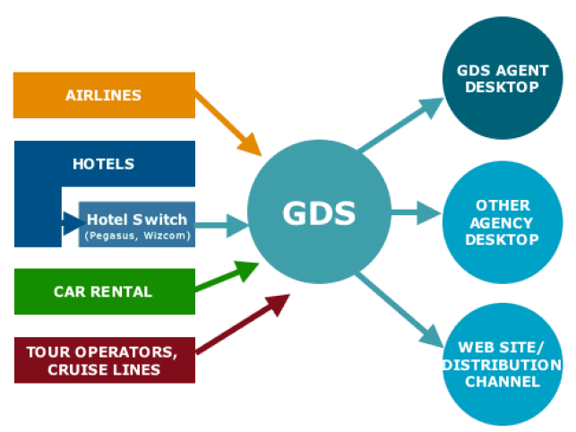
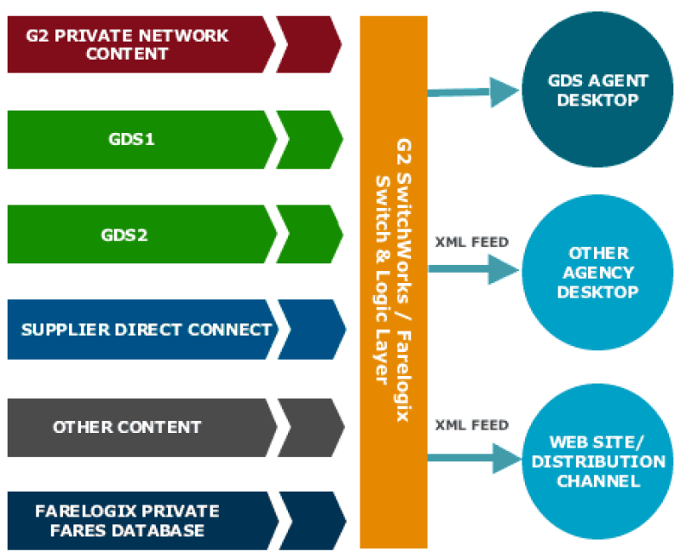
Alternate Distribution System
These players gained the name GNEs for Global distribution systems New Entrants, a moniker that was pronounced "Genies". They were supposed to create a GDS with lower fees but they could not match all the functionalities of a GDS nor support the downstream processes.
The GNE can search multiple individual travel sites (airlines, car rental agencies, hotels, tour operators, cruise lines) as well as other consolidated travel sites (Expedia, Travelocity, Orbitz , and so on) all at the same time.
Traditional GDS model
Proposed GNE model

Slide 44
Examples of ADS or GNE
Some examples of ADS or GNE are:
G2 SwitchWorks: Founded by Alex Zoghlin who is considered the brain behind Orbitz. It promises lower prices and more robust functionality. G2 is backed by nine US airline partners, like Northwest, United, and US Airways who pre-paid large sums to GDS.
Farelogix: Provides a platform and functionality for direct distribution (non-GDS) channel control and optimization, including the capability for custom content delivery and merchandising. FLX Platform for airlines offers functionality comparable to legacy GDS systems, plus value added features, customizable to individual airlines, and at a price point that averages 75% less than GDS distribution costs.
ITA Software: Offers a fare and pricing engine; recently announced an intention to expand into booking. Google acquired ITA in July, 2010. As part of the agreement, Google must license ITA software to other websites for five years.
Navitare: Owned by Accenture. Offers GDS bypass as well as airline hosting solutions.
InterActiveCorp (IAC): Offers private booking solutions to travel suppliers.
SideStep, FareChase, Mobissimo, Kayak: While not actually housing inventory and offering bookings like a GDS, these meta search engines or travelbots scan different travel websites to give customers a global view of pricing and availability.

Slide 45
Direct Connect
Some disadvantages of GDS are:
High transaction costs and fee charged per transaction, per segment
Fee charged irrespective of whether the trip is cancelled
Archaic systems, not easy to change
The shortcomings of GDS has led to the popularity of Direct Connect. Some features of Direct Connect are as follows:
Suppliers are bypassing GDSs and making their fares available to TAs and customers directly by leveraging the internet. This is known as Direct Connect.
Direct connect is possible due to emergence of online booking tools.
As a solution to the problem of revenue leakage, travel suppliers have started establishing Direct Connect interfaces with online travel aggregators such as Expedia.com and Travelocity.com.
On the flipside, cost of developing Direct Connect interfaces separately with each online aggregator in their proprietary formats is cost and time consuming.

Slide 46
Summary
The key points covered in this chapter are:
GDS enables the travel solutions providers by making all travel related products, rates, availability, and other information available on a real time basis.
GDSs were developed on the back of central reservations systems of airlines, and evolving to bring more than airline specific information to consumers.
GDs operate by charging a fee to the suppliers for distributing their content, and fees to travel agent to make bookings.
There are four major GDSs – Amadeus, Travelport (Galileo or Worldspan), Sabre, and Abacus.

Slide 47
Airlines

Slide 48
Context Setting: Overview
This section provides an overview about the Aviation industry. Aviation provides a transportation network across the globe and is crucial for global business and tourism. The use of commercial aviation has grown significantly over the last few decades.

Slide 49
Objectives
After completing this chapter, you will be able to:
Define the classification of airlines.
Describe the overview of the ticketing and fare system.
Define the operation and revenue model.
Identify the metrics used in the industry.
Identify the various processes.
Identify the key players in the industry.
Define the roles of the aircraft, airport, and ATC.
Identify the airline technology vendors.

Slide 50
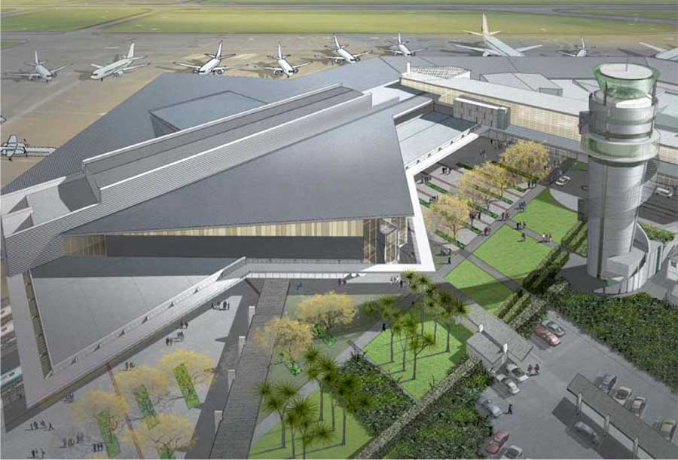
Air Transport
Aircraft
Airlines
ATC

Slide 51
Airlines
The first commercial airline routes were setup in Europe after the World War II.
In many countries, airlines are partly owned by the government but in U.S all major airlines have come to be privately held.
Some classifications based on markets are:
Based on Markets
International
National
Regional
130+ seat planes that have the ability to take passengers just about anywhere in the world.
Companies in this category typically have an annual revenue of $1 billion or more.
Usually these airlines seat 100-150 people.
Revenues earned are between $100 million and $1 billion.
Companies with revenues less than $100 million that focus on short-haul flights.

Slide 52
Classification
Type of load
Passenger
Cargo
Charter Services
Run fixed schedule flights.
Publish timetables.
Open to general public.
Transport Goods only.
Run on demand, unscheduled flights, between custom location.
Fare Structure
Premium Carrier
Low Cost Carrier
Provide extended services and better seating.
Low cost.
Provide bare minimum services.

Slide 53
Ticketing
Some features of ticketing are as follows:
Ticket Sales
A valid booking has to be converted into a passenger ticket (Ticketing).
A Ticket is a contract between the airline and the passenger.
Normally there are three class of bookings – F/C/Y with further sub classes for each of them. The seats in an aircraft are divided among these booking classes.
The number of seats for each booking class keep on fluctuating based on the market demand.
Seats are limited and should be booked in advance. They are available for sale 331 days in advance for a regular flight.
The fares for a particular sector and flight may undergo changes many times before the actual departure.
CRS or GDS assist in passenger bookings.
Airlines may subscribe to one or more GDS for example, SABRE, GALILEO, AMADEUS, and so on.
Ticket Sold By
Travel Agencies
General Service Agents (GSA)
Airline Offices
Airline Websites
Online Travel Agencies

Slide 54
Fares
Some fare rules are as follows:
To avail an airline's services, the passenger has to pay a specified fare.
Every airline publishes fares for its scheduled services.
Published fares satisfy IATA regulations and are freely available.
However, its not necessary for a Passenger to buy a published fare.
An airline is free to offer more competitive fares to attract business.
These fares are not published anywhere, they are called Unpublished or Private fares. They are also referred to as Negotiated Fares or Deals.

Slide 55
Fares (Contd.)
These fares may or may not be known to all agents in a specific market.
Every fare (published or unpublished) has some rules and conditions attached.
Rules or conditions state the travel restrictions.
They are grouped into 30 odd categories, such as:
Eligibility, industry discounts, agent discounts
Day or time of travel, minimum or maximum stay
Seasonality, blackout periods
Flights, routing, and stopovers
Advance reservation or purchase, and so on

Slide 56
Revenue Model
Regular and Business travel
Transporting cargo
Selling frequent flier miles to other companies
Up-selling in flight services
Revenue
Lease or buy the physical aircraft
Labour
Fuel
Hiring Airport capacity
Route structures
Technology
Ticket distribution cost
Expenses
Characteristics
Service Industry – Intangible products
Capital Intensive
High cash flow
Labor intensive
Weather plays a critical factor
Highly competitive market with thin profit margins
Seasonal
Extremely unionized – difficult to operate without union buy-ins

Slide 57
Operations
Key Functions
Flight Scheduling
Fare Quotes
Ticket and Boarding Pass Processing
Gate and Seat Assignment
Baggage Tracking
Inventory Management
Support Functions
Yield Management
Crew Management
Flight Catering
HR and Payroll
Sales and Incentives
Loyalty Programs
Technical Operations
Safety and Insurance Management
Fleet Management

Slide 58
Airline Industry: Metrics
Some key ratios or terms are:
Available Seat Mile: Total number of seats available for transporting passengers multiplied by the number of miles flown during period.
Revenue Passenger Mile: Number of revenue-paying passengers multiplied by the number of mile flown during the period.
Revenue Per Available Seat Mile: Revenue divided by the number of seats available.
Air Traffic Liability (ATL): An estimate of the amount of money already received for passenger ticket sales and cargo transportation that is yet to be provided.
Load Factor: Measures the percentage of available seating capacity that is filled with passengers. Once the airline load factor exceeds its break-even point, then more and more revenue will trickle down to the bottom line.

Slide 59








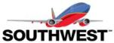
Major Airlines Data: 2011
Airline | Revenue | Fleet Size | Destinations | Employees
 | $31.7B | 716 | 247 | 80,000
 | €23.615B | 594 | 261 | 102,010
 | AED 54.38B | 162 | 103 | 50,000
 | £7.994B | 234 | 169 | 57,000
 | $37.11B | 702 | 377 | 86,852
 | S$14.52B | 106 | 63 | 21,534
 | CNY 83.8M | 351 | 121 | 10,000
 | €27.32B | 710 | 221 | 37,042
 | $ 15.7B | 700 | 97 | 37,000
Notes:
Update data

Slide 60
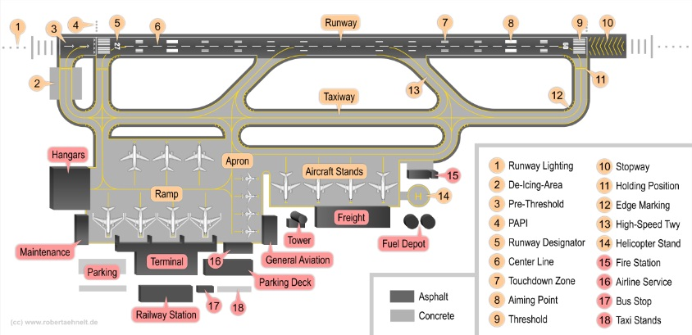
Airport
An airport is a location where aircraft such as fixed-wing aircraft, helicopters, and blimps take off and land. Aircraft may be stored or maintained at an airport.
Airports are divided into landside and airside areas.
Landside areas include parking lots, public transportation train stations, and access roads.
Airside areas include all areas accessible to aircraft, including runways, taxiways, and ramps.

Slide 61
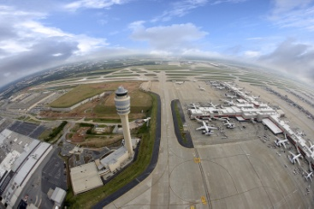
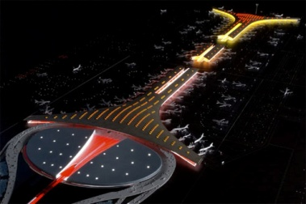
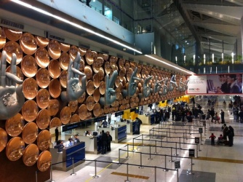
Airport (Contd.)
The waiting areas which provide passenger access to aircraft are typically called concourses, although this term is often used interchangeably with terminal.
Airports are uniquely represented by their IATA airport code and ICAO airport code.
There are a number of navigation aids available to pilots that help in finding direction and landing.
Hartsfield-Jackson Atlanta International Airport
Beijing Capital International Airport
Indira Gandhi International Airport

Slide 62
Air Traffic Control
Some features of Air traffic control (ATC) are:
It is a service provided by ground-based controllers who direct aircraft on the ground and in the air.
The primary purpose of ATC systems worldwide is to separate aircraft to prevent collisions, to organize and expedite the flow of traffic, and to provide information to pilots, weather, and navigation information. Preventing collisions is referred to as separation, which is a term used to prevent aircraft from coming too close to each other by use of lateral, vertical and longitudinal separation minima.
Many aircrafts now have collision avoidance systems installed to act as a backup to ATC observation and instructions.
When controllers are responsible for separating some or all aircraft, such airspace is called controlled airspace in contrast to uncontrolled airspace where the aircraft may fly without the use of the ATC system.
Depending on the type of flight and the class of airspace, ATC may issue instructions that pilots are required to follow, or merely flight information to assist pilots operating in the airspace.

Slide 63
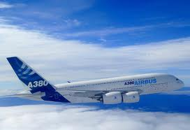
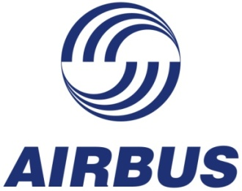
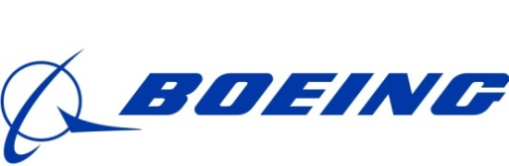
Aircraft
An aircraft is a vehicle that is able to fly by gaining support from the air, or in general, the atmosphere of a planet. An aircraft counters the force of gravity by using either static lift or by using the dynamic lift of an airfoil, or in a few cases the downward thrust from jet engines.
Airbus and Boeing are the largest manufacturers of aircrafts in the world.
Airbus A380 is the largest civilian aircraft in the world.

Slide 64











Snapshot of Airline Technology Vendors
Domain / Technology Area Served | Representative Vendors
MIS Systems
Financial Management
Booking Engines and Reservation Systems
Engineering, Repair and Maintenance (MRO) Systems
Crew Management
Fleet Management
CRM
Yield Management Systems

Slide 65
Summary
The key points covered in this chapter are:
Airlines play an important role in the world economy.
Airlines are classified based on parameters like market, type of load, and fare structure.
Some key ratios or terms are Available Seat Mile, Revenue Passenger Mile, Revenue Per Available Seat Mile, Air Traffic Liability (ATL), and Load Factor.
An aircraft is a vehicle that is able to fly by gaining support from the air, or in general, the atmosphere of a planet.
ATC(Air Traffic Control) is a service provided by ground-based controllers who direct aircraft on the ground and in the air.

Slide 66
Hospitality

Slide 67
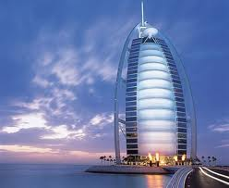
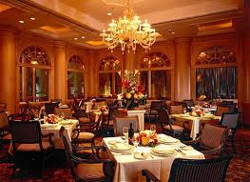

Industry Constituents
Hospitality, broadly refers to hotels and restaurants.
Hospitality
Hotels
Amusement parks and Recreation hubs
Restaurants

Slide 68
Objectives
After this chapter you will be able to:
Identify hotel classification, segments and ratings.
Recognize how hotel companies are structured and operated.
Define the hotel organization.
Recognize two areas of technology use.
Identify some core operational metrics.
Recognize the leading hotel brands.

Slide 69
Context Setting: Overview
Hotels can vary in size, function, price, and so on. Over the years, hotels have evolved from basic lodging providers to encompassing a holiday destination in itself. In this section, the key concepts of the hotel industry will be introduced.

Slide 70
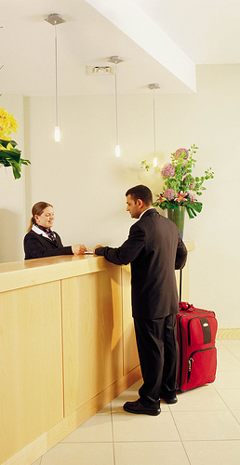
Hotels: Concept
Some common concepts of the Hotel industry are as follows:
Hospitality industry consists of business institutions that provide accommodation, food, and other services to travelers.
The term Hotel is generally used to refer to any establishment that provides private rooms and maintains service staff to assist guests.
The facility where accommodation is provided, is referred to as a Property.
Several properties owned or operated under the same name or managed by the same company is a Chain.
Customers are called Guests or Clients.
High season is a period of peak activity while low season is a period of slack activity.

Slide 71
Developments in the Industry
1800s: Central heating, elevator, and electric lights
1900s: In-room telephone, in-room radio, and air conditioning
1950s: Electric elevator, free television
1964: Holiday Inn central reservation. 1965: Message light on telephone
1970s: Electric cash register, POS, keyless lock, and color television standard
1980s: Property Management system, in-room guest checkout
1983: In room personal computer, call accounting
1990s: GDS distribution
2000s: Advent of www, and online TAs. New distribution and booking channel
2004: Advent of social media.

Slide 72
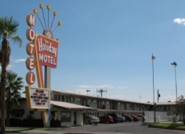



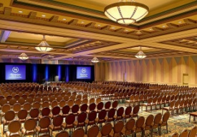
Classification: Purpose Based
Some hotel classifications are:
Motel: On highways. Offers accommodation to motorists; rooms are accessible from exterior.
Casino Hotel: Often quite luxurious. Main purpose is in support of the gambling operation; often offer top name entertainment and excellent restaurants.
Resort Hotel: Primarily for leisure travelers. Emphasizes recreation; resorts are located at the ocean or in the mountains away from inner cities.
Suite or All-Suite Hotel: Provides separate sleeping and living areas in all rooms.
Convention Center: Designed to provide large meeting space along with guest rooms; provide all services and equipment necessary to handle conventions.
Business hotels: Usually located in central business districts catering to business visitors.

Slide 73
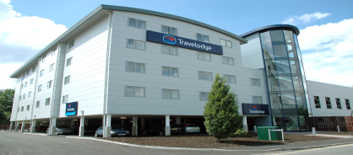



Segments
Hotel segments are characterized by a set of common traits, for example, by price, luxury and service. Some segments are:
Economy or Limited service: Provides clean rooms at low prices meeting the basic needs of travelers only.
Mid Market: Provides above average luxury, comfort, food, and beverage.
First Class: Luxurious, with well trained staff and exceptional food and beverage facilities.
Luxury: Also called deluxe hotels; offer the highest standard of excellence in luxury, comfort, efficiency, food, and beverage.
The logos are an example; it is possible that each of these chains may operate brands in other segments as well.

Slide 74
Star Rating
Budget hotels: With limited facilities.
Comfortable hotels: Primarily budget hotels with functional accommodation.
Very comfortable hotels: Dependable, comfortable hotels with standardized rooms, amenities and public areas.
Travel professionals and industry observers laugh at six and seven-star ratings, saying there are no ratings higher than five stars. An example of a five-star hotel which is branded as a seven-star hotel is the Burj al Arab.
First class hotels: Superior hotels specifically designed for the first class market with some outstanding features.
Deluxe Hotels: Exclusive luxury hotels offering highest standards of service, facilities, and accommodation.
Notes:
There is no globally accepted rating standard, each country has its own apex body that determines the rating system. The star rating however is most commonly recognised by travelers world over

Slide 75
Structure and Operations
Generally hotel companies are organized by brands. Each brand will have multiple properties under that name. While it is necessary that the brand is owned by the parent company, individual properties or hotels may not be. They may be franchised or managed properties.
Indian Hotels Co.
Taj
P1
P2
Vivanta
P1
Holding or Parent Company
Brand or Chain
Property or Hotel
Gateway
P1

Slide 76
Ownership Model
Some ownership models are:
Ownership: Range from publicly held companies to family and individuals. The parent company owns the property.
Chain: A collection of hotels that are either owned by one organization or have a strong management or franchise agreements which dictates how each hotel will operate.
Franchise: Collection of individual hotels who align themselves to a brand name, in return for franchise fees receive marketing, purchasing, and reservation management services. Franchisees pay a fixed percent of receipts to a franchiser for advertising and royalties. Some hotel franchisers lease the structure to the franchisee for a monthly rate or a percentage of sale.
Management: Hotel companies sign a contract with independent property owners to operate and manage the hotel under their brand.
Consortia: Collections of hotels that buy the services of a central organization.
Representation: Provides a variety of services to independent hotels or very small hotel groups.

Slide 77
Industry Operations
There are four basic types of hotel ownership and management. They are:
Owned and operated hotel: May have investors or others with a financial interest in the hotel, but the ownership structure is in one person or company's name.
Managed hotel: Also privately owned; but has signed an agreement with another hotel brand to run the hotel operations.
Leased hotels: Owned by an individual or company, but the physical building is on lease.
Franchise operation: Privately owned; but the owner pays an up-front fee to purchase the franchise along with ongoing royalties.
 | Construction | Operating Procedure | Manpower | Central Procurement | Loyalty Program | Central Reservations | Other Applications
Ownership
Management Contract
Leased
Franchise
Yes
Sometimes
No

Slide 78
Income Source of the Business
Revenue from rooms is the core business
Food and Beverage: Restaurant, Bar, Catering, Room Service, Mini Bar
Others: Business Centre, Meeting rooms, Laundry, Spa and Fitness Centre, Internet and Telephone, Gift Shop, and so on.
$ $ $

Slide 79
Organization: Property Level
General Manager
Front Office
Reservations
Reception / Guest Relations
Rooms Division
Concierge
Bell Desk
House-keeping
Food and Beverage
Restaurants and Bar
Room Service
Banquet/ Catering
Kitchen
Back of the House
Sales and Marketing
Finance and Accounts
Human Resources
Engineer-ing
Security
At the property level the hotel’s operational structure may look like this; the organization may vary depending on the size and type of operation. This leads to many more functional departments or overlapping of responsibilities.

Slide 80
Property Management System
Property Management System (PMS) is a computerized system at the property level. Some of its features are as follows:
It handles the daily routine transactions at a basic level. It is used to make reservations at the property level.
It links all operations in a hotel interfacing with Point of Sales (POS), telephones, door lock, and so on.
It can be interfaced with other third party systems.
It can store guest information.
Only employees at the property have access to it.
House-keeping
Reservation Management Check in/out
Concierge Services
Room Inventory
Group Management
Cashiering
Payments
Yield Management
Account Receivable
Guest Folio and History
Sales and Catering
3rd party application
interface
Property Management System

Slide 81
PMS Interfaces
The PMS automates hotel functions. It can be integrated with other technology systems to send information to the various departments of a hotel.
Housekeeping
Red Rose and Wine
Loyalty System and Loyalty Card with RFID
Front Office
Sea facing room
Other Property PMS
Central Reservation and Customer Information System
PMS
(Reservation and Customer Profile)
Restaurant
Vegetarian
Room Service
Earl Grey tea
Point of Sales System
Mobile Phones
PDA
Desktop
Pager
SMS Application
Car Announcement
Information Exchange

Slide 82
Central Reservations System
Some features of the Central Reservation System (CRS) are as follows:
CRS is independent of the hotel, and operates at the corporate level. It is also known as the Central Reservation Office.
It operates as a call centre where customers can call to make reservations.
Reservations for all hotels from the same chain can be made through CRS.
Hotel specific information, such as inventory, rates, availability, and so on, flows from the PMS to the CRS.
CRS is the crucial interface with the GDS and information from the CRS also flows to the brand and OTA websites.
TAs, customers, and property level employees do not have access to CRS.
CRS
GDS
OTA
Client/ Guest
Brand. com
PMS

Slide 83
Availability, Rates, and Inventory
Availability
Is the number of rooms available for booking at any point of time
Availability = (Authorized Inventory – Sold out rooms – Restricted rooms)
Rate
Rates are the actual amount of money payable to a property for a room i.e. room rent or price, sometimes referred to as tariff
Inventory
Is the total number of rooms a property is authorized to sell

Slide 84
Reservations
Reservation is the process of booking a room at the hotel. Some attributes of reservation are:
Reservations can be made via:
The hotel’s reservations department; the booking is captured in the PMS
The Central Reservations Office, which is located away from the hotel; the booking is captured in the CRS
The Internet; on the hotel website or online TA
TA
A reservation consists of two main sets of information:
Guest data is information about the customer. For example, name, address, contact details.
Booking data consists of hotel specific information such as room type, rate.
All reservations made have these attributes:
Guarantee Policy: Required by the hotel from a customer to guarantee a room. Usually includes the requirement of a credit card number or an advance payment which may be forfeited if the guest cancels or no shows.
Cancellation Policy: Provides customer time limits until which he may cancel his booking at either no cost, partial cost, or full cost.

Slide 85
Performance Metrics
The key operational metrics used to measure performance of a hotel are Occupancy, ARR, and REVPAR are rooms related metrics.
Occupancy
Number of rooms that are occupied on a given night
Calculation: Occupancy (%) = (No. of occupied rooms / Total rooms) *100
ARR
Average Room Rate takes into account the total revenue generated for the total number of occupied rooms during a specific time period
Calculation: ARR = Total revenue / No. of rooms occupied
REVPAR
Revenue Per Available Room is the average price per room taking into account total revenue generated for the total number of rooms
Calculation: REVPAR = Total revenue / No. of total rooms at the property

Slide 86
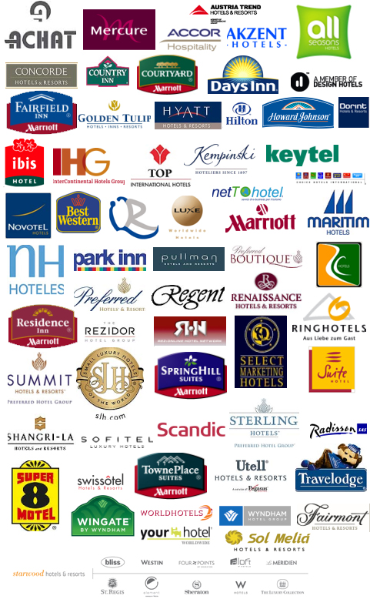
Global Hotel Brands

Slide 87
Summary
The key points covered in this chapter are:
Hotels have evolved from providers of basic lodging to destinations in themselves.
Hotels may be categorized on the basis of location, service, and facilities.
Central Reservations system is a key IT system that links all properties of a hotel and provides real time information on availability and rates.
Key performance metrics for hotels are Occupancy, ARR, and REVPAR.

Slide 88
Restaurants

Slide 89
Objectives
After completing this chapter, you will be able to:
Identify the trends in the industry.
Recognize the various restaurant formats and business models.
Identify the key players in the industry.
Define Customer Relationship Management System and the Kitchen display system.
Identify the use of the brand portal and the point of sale system.
List the various processes.

Slide 90
Restaurant Industry: Overview
Restaurant sales in North America is expected to go beyond US$ 604 billion in 2011 – 2012 (more than $1.7 billion per day).
The overall economic impact of the industry is expected to exceed US$ 1.7 trillion in 2011-12, including sales in related industries such as agriculture, transportation and manufacturing, ITES, and so on.
Earlier research suggested that every dollar spent by consumers in restaurants generates an additional US$ 2.34 spent in other industries allied with the restaurant industry.
In 2011-12, the industry has become one of the largest private sector employers engaging more than 12.8 Million people all over the world.
The industry, on average, commands 49% share of an individual’s food bill in US and other western countries.
Source: www.restaurant.org

Slide 91
Restaurant Industry: Overview (Contd.)
About 8 % or more US citizens are likely to dine out at least every few days.
Americans spend nearly US$100 billion on fast food every year.
Between 1977-78 and 1994-96, the share of daily caloric intake from food away from home, in US, increased from 18% to 32% percent.
Spending on such foods has also grown to account for about half of total food expenditures in 2004, up from 34% percent in 1974.
Another trend is companies attempting to associate their food products with popular health-oriented brands in order to tap into the trend toward healthier eating.
Heavy expansion is expected in less traditional locations like airports, hotels, and theme parks.

Slide 92
Restaurants Business Model
Restaurant Business Model
Single Unit
Multi Unit
The advantages of Multi Unit (Chain) restaurant organization are:
Brand recognition
Help from the franchisor
Ease of selling restaurants
Potentially easier employee recruitment
Benefits of centralization of menu planning, purchasing, or standardization

Slide 93




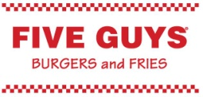

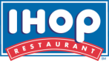

Types of Restaurants by Operations
Restaurants
Upscale
(Fine Dining, High Average Check Value)
Casual Dining
Fast Casual
Quick Service Restaurants (QSR)
Full Service
Specialty
A casual, fast casual, or QSR can be specialty restaurants as well.
Full service restaurants usually belong to Casual and Fast Casual categories.
Various cuisine-based brand concept chains may exist for each type of restaurants.
Usually one brand chain adopts a specific operational category across geographies.
One brand corporate can have similar multiple operational structure based chains under different legal entities and franchises in multiple geographies. For example, Pizza Hut and PHD in Asia.

Slide 94
Types of Restaurants
By Coverage:
Full Service: Breakfast | Lunch | Dinner | 24x7
Limited Service: Bars | Pub | Lounge | Café | Bakery | Specialties | Diners | Parlors
By Nature of service delivery:
Dine In
Table Service: Casual Dining | Fine Dining | QSR
Quick Service: Fast Food | Café | Bakery
Catering
Retail
Take Away
Pick Up/To go
Airlines
Institutional
Drive Thru
Curb Side
Door Step Delivery

Slide 95
Restaurant Formats
Some formats in the resturant are:
Full service or table service:
Elaborate menu, cooked to order, and labor intensive
High service quality expectations, experiential, and expensive
Quick service:
Standard menu, assembled to order, and process intensive
Fast service expectations, efficient, and inexpensive
Buffet service:
Limited menu, assembled to order, and process intensive
Variety expectations, efficient, and inexpensive
Specialties:
Unique menu, cooked to order, and labor intensive
High service quality expectations, experiential, and expensive

Slide 96
Restaurant Formats (Contd.)
Full Service Restaurants:
US consumers seeking an enjoyable dining experience are more likely to patronize Full Service Restaurant.
US Consumers who are looking for healthy foods are also more likely to patronize Full Service Restaurant than they are to pick fast-food outlets.
In the Full Service category, steak and Italian themed restaurants are growing around 10% while most other formats are growing between 6% and 7%.
Fast Food Restaurants:
Over 25% of Americans consume fast food every day.
Americans spend nearly US$100 billion on fast food every year.
Worldwide, there are more than 500,000 fast food places. Subway is the largest by the number of outlets, McDonalds being a close second.
There are close to 50,000 fast food chains across the United States, with Subway and McDonalds being among the largest restaurant chains.
In US, Kids between the ages of 6 and 14 eat fast food 157,000,000 times every month.
Quick service restaurants are looking towards co-branding to increase market penetration.
Ninety-six percent of kids in US schools could recognize an image of Ronald McDonald, the face of McDonalds, next only to Santa Claus.

Slide 97









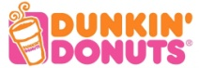
Key Players
Name | Geographic presence | No: of outlets | Revenues | Type of Chain and Brands
McDonalds | Global | 32000 + | $ 24 bn | Quick Service Restaurant
Subway | Global | 34,700 + | $ 15.2 bn | Specialty Quick Service Restaurant
YUM! Brands | Global | 38000 + | $ 11 bn | 1. KFC, 2. Pizza Hut 3. Taco Bell 4. Long John Silvers 5. WingStreet 6. A&W
Brinker | Global | 1500 + | $ 2.85 bn | 1. Chili's Grill & Bar 2. Maggiano's Little Italy
Jack in the Box | US | 2700 + | $ 2.76 bn | Jack in the Box (QSR) Qdoba Mexican Grill (Fast-Casual)
Wendy’s | Global | 10000 + | $ 12 bn | Quick Service Restaurant
Burger King | Global | 12000 + | $ 2.5 bn | Quick Service Restaurant
Darden | Global | 1800 + | $ 7.2 bn | 1. Oliver Garden 2. Red Lobster 3. LongHorn Steakhouse 4. Seasons 52 5. The Capital Grille 6. Bahama Breeze
Starbucks | Global | 17000 + | $ 10.7 bn | Coffee Chain
Dunkin’ Brands | Global | 14800 + | $ 6.9 bn | 1. Dunkin’ Donuts, 2. Baskin-Robbins

Slide 98
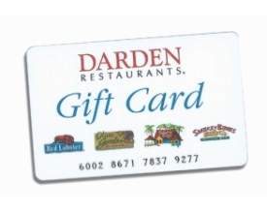
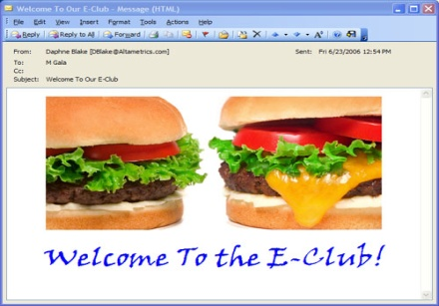
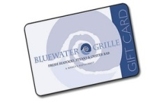
Customer Relationship Management
Customer Relationship Management (CRM) is a concept used by restaurants to manage their relationships with customers, including the capture, storage and analysis of customer, vendor, partner, and internal process information.
CRM analyzes customer data for a variety of purposes:
Design and execution of targeted marketing campaigns
Customer acquisition, cross-selling, up-selling, and retention initiatives
Analysis of customer behavior to aid product and service decision making. For example, new product development
Financial forecasting and customer profitability analysis
To carry out CRM initiatives, CRM related Hosted Software Solutions are available. These are scalable, high-performance web-based software and comprise various modules like:
E-mail marketing
Stored value cards (Gift cards or coupons)
Loyalty cards
Sales promotions

Slide 99
Brand Portals
Restaurant websites need an appealing, user-friendly design, and functionality, including accessibility and interactivity.
Regular Features
Special Features
General brand information
Store locator (may include parking information)
Menu (with appealing photographs)
Nutrition information
Gift Card purchase and balance checking facilities
Secure transaction capability
Online promotions, competitions, games, and online interactive activities
Brand memorabilia, merchandise, and downloads
Country and language options
Social responsibility initiatives
Careers link, news links, and franchisee links
Online Ordering
Build a meal or nutrition calculator option
Invite a friend option
Brand Advertisements
Virtual tour of the restaurants
Ringtone and other downloads
Customer satisfaction surveys and customer info forms
Brand communities, e-mail groups
Children's section, parents section
Catering and picnic tips and suggestions
Notes:
Brand positioning defines the essence of a product or service. This includes intended benefits, personality, and expected behavior.

Slide 100
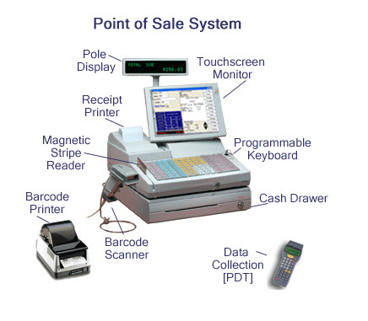
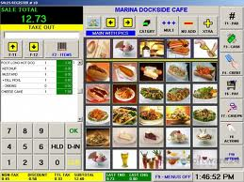
Point of Sale
Point of Sale or Point of Service (POS) refers to the location in a restaurant where a transaction occurs. POS often refers to the hardware and software used for checkouts, the equivalent of an electronic cash register.
The types of Ordering through POS are:
In store ordering
Take Away orders
Catering
The types of POS are:
Unified POS (UPOS) is a retailer-driven initiative to combine two existing device interface standards (OPOS and Java POS) under one specification to allow retailers freedom of choice in the selection of POS devices
Wireless POS (WPOS) is the use of wireless devices to facilitate order-taking or payment for checks.
POS User Interface

Slide 101
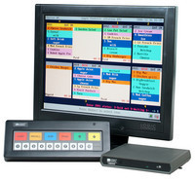
Production Planning
The Kitchen Display System (KDS) works as the Production Management System for restaurant operations. The main function of KDS is to dispatch a food order from the order entry system to the appropriate kitchen stations for food preparation without the transfer of paper order slips or voice communication. Some of the basic functions of KDS:
The KDS is designed to display kitchen order information to a kitchen monitor.
The orders originate from POS input and are sent to the KDS through the store network.
As each order is completed, the user can bump or delete the order from the queue by using the attached Bump Bar.
Order information can also be printed from each KDS by attaching a printer to it.
Notes:
The KDS works as the production management system for restaurant operations. Its main function is to dispatch a food order from the order entry system to the appropriate kitchen stations for food preparation without the transfer of paper order slips or voice communication. KDS is designed to display kitchen order information to a kitchen monitor. The orders originate from POS input and are sent to the KDS through the store network.

Slide 102
Processes
Corporate
Processes
BOH
Processes
FOH
Processes
HR
Payroll
Food Cost Accounting
Marketing and Sales
Treasury
New Product Development
Supply Chain Management
Real Estate Management
Information Technology
Franchise Management
Business Intelligence (BI)
Customer Relationship Management (CRM)
Account Payables/ Receivables
Master Data Management
Recipe Management, Menu Management
POS Sale
Customer Facing Processes
Counter
Drive Through
Kiosk
EOD
Clock in/ Clock out
Customer Facing Processes
Kitchen and Production Management
Calculating daily staffing requirement based on expected load
Measure time taken to serve customer specially in a QSR
Labour Scheduling
Speed of Service (SOS)
Inventory is maintained based on current levels, consumption and forecast
Calculate the wait time for the guest and optimize table allocation (Casual Dining Restaurant)
Inventory Management
Table Management
Call Centre for Home Delivery and Pick Up Operations
Portal

Slide 103
Restaurants: Summary
The key points covered in this chapter are:
Restaurant industry has a highly competitive market. It is growing fast with newer trends emerging and increasing customer focus on nutritional and healthy food.
Customer facing functions or the Front of House is where all the sales and customer interactions take place. This is instrumental in not only in driving sales but also in delivering customer satisfaction and driving long term growth through relationships.
The Back of House or back office of the restaurants takes care of all the ground work behind serving up the final dish to the customer. From food production to accounting and IT, everything pertaining to the store level takes place here.
The corporate office is the brand head office. It is also the central corporate house in case of multiple brands or concepts. This is where all the stores across states and concepts are guided from. The long term vision, mission, strategies, and planning is all done at the corporate and then percolates down to individual stores for execution.

Slide 104
Cruise, Rail, Bus, and Car Rental

Slide 105
Context Setting: Overview
The T&H industry also consists of other suppliers such as cruise lines and various modes of transport and travel. In this section, four suppliers will be introduced.

Slide 106
Objectives
After completing this chapter, you will be able to:
Describe cruise lines.
Describe railways.
Describe car rental.
Describe bus or coach operator.
Identify some leading brands.

Slide 107
Cruise
Some features of Cruise liners are as follows:
Cruise lines operate passenger ships for leisure trips, where the voyage itself and the amenities provided on the ship are part of the experience.
Cruise lines have a dual character; they are partly in the transportation business, and partly in the leisure entertainment business. Similarly, they have a crew headed by the ship's captain, and a hospitality staff headed by the equivalent of a hotel manager.
Cruise liners are organized a great deal like floating hotels.
Crew is hired on contract for three to eleven months, which may be renewed on mutual agreement.
Construction market for cruise ships is dominated by two European companies (Italy and Germany) and two Asian (Korea and Japan) companies.
Two major operators are Royal Caribbean Cruise and Carnival Cruise lines.
Cruise Lines International Association (CLIA) is an association of cruise lines. As of February 2012, 26 cruise lines were members of CLIA.

Slide 108
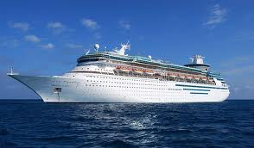
Cruise (Contd.)
The facilities in a modern cruise ship are:
Casino
Fitness center
Shops
Library
Theatre and cinema
Swimming pool
Hot tub
Lounges and clubs
Gym
Cruise Liner

Slide 109
Railways
Rail transport is a major form of passenger and freight transport in many countries. Some kinds of trains are:
Passenger trains: They travel between stations where passengers may embark and disembark. They involve a variety of functions starting from long distance travel, daily commuter trips, to local urban transit services.
Intercity long haul trains: They operate on longer routes between cities with lower stops. They have lower frequency. Thay also have dining cars and sleeping arrangements.
High speed rail: These are special inter city trains that operate around 200 to 320 km per hour. They are mostly prevalent in Western Europe and East Asia, for example, TGV (Spain), Bullet (Japan).

Slide 110
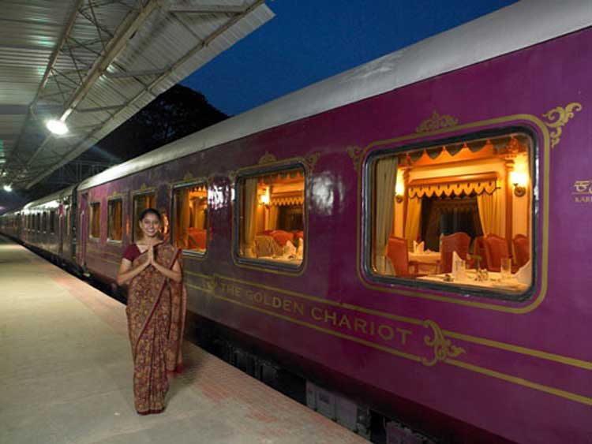
Railways (Contd.)
Some trains are run exclusively for tourism and may cover scenic, cultural, historical and other routes. These trains have sleeping and dining facilities; they are like hotels on rail tracks. Some such trains are :
Orient Express
Danube Express
The Royal Scotsman
Palace on Wheels
Golden Chariot
Rocky Mountaineer
Jewel of the Desert
The Golden Chariot

Slide 111
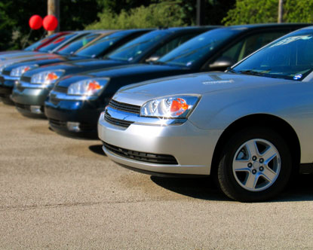
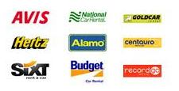
Car Rental
Companies rent automobiles ranging from a few hours to few days depending on the usage. They have a detailed operation with numerous branches to serve as pick-up and drop-off points. Some features of car rental are:
They operate by purchasing or leasing cars.
Rentals can offer a wide array of cars for their customers to suit their budget and space requirement.
Motorists pay for the rent of the car and for fuel and for any toll fees or fines that they incur during their journey.
They can opt for Insurance, GPS, and other facilities.
Many prefer this method as they have complete control over their travel. It can also be cheaper than other modes.
Association of Car Rental Industry Systems and Standards (ACRISS) is a code used by many car rental companies to allow uniform classification and easy comparison of car rental prices.
Hertz is one of the longest established rental companies, originally started in 1918 by Walter L. Jacobs as Rent-a-Car.
Car Rental Companies

Slide 112
Bus
Bus tours could include:
point to point travel
Intra city or local sight seeing for a group of tourists, accompanied by a tour guide
Multi-city trip by road for a group accompanied by a tour guide
During the trip, travelers stay overnight at hotels but will use the bus to do local sight-seeing and to travel to their next destination.
The journey usually begins and ends at the same location.
This is a very popular way to cover a large area of special interest.
Bus type includes single decker, double decker, and articulated bus. It varies from country to country.

Slide 113
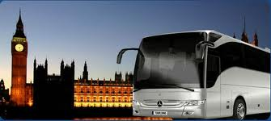
Bus (Contd.)
Some operators are :
Cosmos
Shearings
Buses are normally used for:
Public transport
Tourism
Student transport
Private charter
Promotion
Bus Transport System

Slide 114
Summary
The key points covered in this chapter are:
The forms of transport discussed in this section have evolved to become a key provided of the travel and tourism industry.
Ships, trains, buses are no longer just a point to point carrier but an integral provider of an holistic travel experience.
Some modes of travel, such as a cruise or specialty trains, are a holiday in itself.

Slide 115
Trade Associations

Slide 116
Objectives
After completing this chapter, you will be able to:
Identify some of the major trade associations in this industry.

Slide 117
Open Travel Alliance
Open Travel is a not-for-profit trade association founded in 1999 by travel companies.
Its primary focus is on the creation of electronic message structures to facilitate communication between the disparate systems in the global travel industry.
Engineer specifications to ensure traveler and supplier information flow smoothly throughout travel, tourism, and hospitality.
Creates, expands, and drives adoption of open specifications, including but not limited to the use of XML, for the electronic exchange of business information.

Slide 118
Travel Trade Associations
World Tourism Organization – Global forum for tourism policy issues
IATA global representative of international scheduled air transport industry
UFTAA represents national TAs organizations of more than 100 countries
ASTA/PATA – Regional Travel Agent associations
IH & RA (International Hotel and Restaurant Association) Headquartered in France
AH and LA (American Hotel and Lodging Association) Headquartered in Washington D.C.
This is not an exhaustive list and there are many global and regional associations

Slide 119
Summary
The key points covered in this chapter are:
The industry players cooperate with each other through different trade associations.
The associations provide structure to the industry.
These associations help in setting standards, promoting best practices, protecting the rights of the consumers, and facilitating interaction with the governments across the world.

Slide 120
Glossary

Slide 121
Context Setting: Overview
The T&H industry follows some industry-specific terminology. This chapter will discuss some of these T&H terms.

Slide 122
Objectives
After completing this chapter, you will be able to:
Identify the basic terms used in the T&H industry.

Slide 123
T&H Terms
Global Distribution Systems (GDSs): Electronic travel distribution networks that facilitate connectivity, shopping, and booking among thousands of travel suppliers and more than 163,000 travel agencies around the world; contains information such as price, availability, and so on for all types of travel products.
Corporate travel: Managed or corporate travel refers to all travel expenses made by corporations. Purchases are governed by a formal travel policy; travel for business.
Segment: The base component of a booked transaction is measured by a GDS. A segment represents a flight from point A to point B for a single passenger.
Supplier (or travel supplier): An owner or operator of a travel service, such as an airline, hotel, car rental company, or cruise line.
Intermediary or Retailer: Resells suppliers’ products, such as, a travel agency.
TA : Travel Agent.
Travel Management Company (TMC): A type of travel agency that provides management and consulting services for corporate travel programs.

Slide 124
T&H Terms (Contd.)
OTA : Online Travel Agent.
IDS : Internet Distribution System.
BAR : Best Available Rate.
Computer Reservation System (CRS): A system for an individual airline containing information on that airline only; used by that airlines’ employees.
Direct Connect: Providers are bypassing GDSs and making their fares available to TAs and customers directly by leveraging the internet. This is known as Direct Connect.
Fulfillment and Ticketing: Process by which the TA or portal issues a formal document to the customer validating the purchase of flight ticket, hotel room, or car rental. A ticket is a formal travel document representing a contract between the traveler and the supplier.
Supplier: A provider of travel arrangements like an airline supplies seats, a hotel supplies rooms, and a car rental company supplies cars.

Slide 125
T&H Terms (Contd.)
Tours: A travel product in which several elements are bundled together and sold as a single unit. Tours typically involve the use of a guide, host, or escort by groups (as opposed to packages which do not).
Web Fares: A web-direct fare is a fare distributed exclusively through an airline’s internet website. In some cases, web-direct fares are cheaper than standard fares. At the same time, significant restrictions or penalties may apply to a web-direct fare if it is changed or cancelled.
Pricing: Process by which a provider assigns a price to its inventories. Usually this is statistically generated based on demand, seasonality, promotion, competition, and so on. In the airline industry, inventory price is extremely dynamic and is calculated by the airline so as to maximize its yield (revenue per passenger mile).
Promotions: A limited duration campaign to sell the providers inventory by providing sops to customers. These sops can be the reduced price of the inventory, two for the price of one offers, gift items or free services.

Slide 126
T&H Terms (Contd.)
Rack Rate: Standard advertised rate for a room or suite; if the customer asks for a lower rate, they often get it.
Yield Management: The practice of adjusting prices up or down in response to demand in order to control yield.
Packages: A travel product bundling several distinct elements, such as air travel, a rental car, and a hotel. A package is distinguished from a tour by virtue of the fact that it combines fewer elements.
Passenger or Guest: Denoted by PAX in the travel industry.
PNR and GNR: Passenger Name Record and Guest Name Record respectively.
Inventory Management or Control: Closely linked to Yield management. Leisure travelers tend to book very early at lower restricted fares, while business travelers tend to book closer to their departure date at higher, unrestricted fares. With inventory control, the correct number of seats are saved or protected for late-booking higher-fare passengers, while allowing the remaining seats to be sold to leisure passengers paying lower fares.

Slide 127
T&H Terms (Contd.)
Net Rate: The rate at which the supplier sells its inventory to a intermediary, such as a wholesaler or retailer, to which the latter adds a mark-up before selling the to a customer.
Code Share: Two airlines agreeing to share PNRs in an itinerary. A ticket may be issued under either airline and the flight may have two or more numbers.
Interline
Inline
Boarding Pass: Coupon given to the traveler after check-in which assigns a seat number; gate number not usually present in the ticket.

Slide 128
T&H Terms (Contd.)
Revenue Management: One of the most important function in the airline. The aim is to maximize revenues from the sale of seats. This means that the fares for an airline may change at any given moment of time. Revenue management and inventory management go hand in hand. Depending on the booked and available seats capacity, the airline may decide to increase the number of seats in a particular class. Revenue management is a complex process using various statistical models and forecasting tools. It utilities the historic booking trends, forecasted demand, and current load factor to define the seats to be allotted for each class.
Hub and Spoke: Flight between A and C has a stopover at B which is the hub.
Point-to-Point: No hub between points A and C.

Slide 129
T&H Terms (Contd.)
Type Of Journeys:
International and Domestic
One Way (OW) – Travel between two cities. A to B
Return trip (RT) – Travel between two or more cities with return back to point of origin. It contains two components, Outbound and Inbound.
Round Trip – A to B to A
Circle trip – A to B to C to D to A
Type of Flights: For traveling between two cities, there are numerous ways the flights can be operated:
Non Stop
Direct: Via another city without any aircraft change
Connecting flights: Involves change of aircraft and flight number at an intermediate point
Online: Entire travel on a single airline
Interline: Involves travel on two or more airlines

Slide 130
T&H Terms (Contd.)
Seating Configuration: Total number of seats available on an aircraft and how have they been arranged. Same airplane type can have different configuration for different routes in the same airline. Different airlines have different configurations as per their polices. Typically there are less seats in First class, least in Business class, and maximum seats in economy class.
Overbooking: Airlines occasionally overbook flights, meaning that they book more passengers for a flight than they have seats on the same flight. This is not an oversight but carried out intentional to counter no-shows at the last moment. The overbooking factor is based on average no-shows and historical data and trends.
Fleet Planning: Plan catering to the procurement and deployment of various aircrafts. It depends on airline route network.

Slide 131
T&H Terms (Contd.)
Break-even Load factor: It is the percentage of the seats the airline has in service that it must sell at a given yield, or price level, to cover its costs. Airlines typically operate very close to their break-even load factor. The sale of just one or two more seats on each flight can mean the difference between profit and loss for an airline.
Self Service Devices: Kiosks located at airports and other strategic locations allow the passenger to check-in on his own and get his boarding pass. They also allow the passenger to perform additional operations like further bookings, changes, and so on.
Front of house (FOH): Covers everything from the moment a customer makes a reservation (online, on the phone, or in person) till they leave.
Back of house (BOH): Refers to the area of a restaurant that guests are not allowed. The kitchen, dishwashing area, and wait station are all located in the BOH.

Slide 132
T&H Terms (Contd.)
Point of Sales (POS): Electronic cash register where the transaction occurs.
Menu Mix - Menu items that are for sale through POS at FOH; these are things that the customers buy and consume.
Kitchen Display System (KDS) - Production Management System for restaurant operations.
Catering: An event catering where food is served with waiting staff at dining tables or a self-serve buffet is set up.
EOD or EON process: To consolidate and transfer daily sales and labor related data to the Corporate.
Price Tier: Pricing bands (region, location, or store type specific).
Unit of Measure (UOM): Definite magnitude of a physical quantity.
Day part: Restaurants serve breakfast, lunch and dinner at different times of the day and these form the distinct dayparts.

Slide 133
T&H Terms (Contd.)
Check or Ticket: List of the items consumed and the expenses.
Loyalty Program: A marketing program that rewards customers with discounts and rebates for their repeated business. They provide sellers with information about the customer's purchasing patterns.
Ala carte: A menu on which food and beverages are listed and priced individually.
Product Holding Unit (PHU): An equipment to pre-cook the ingredients and hold them in a heated holding cabinet. The quantity varies as per the forecasted demand.
Labor Scheduling: Assigning the right employees with the right skills to the right job at the right time.
Table Management: Comprises of activities like reservations, maintaining a log of waiting guests, and assigning tables to guests in a restaurant.

Slide 134
T&H Terms (Contd.)
Wait Time: Period of time which one must wait in order for a specific product or service to be delivered. It determines the Speed of Service.
Dine-in-Restaurant or Food outlet: Provides tables to sit down and eat the meal.
Take-out: Facility for customers to order food by telephone, fax, or over the Internet but has to be collected from the outlet.
Drive-Thru: Type of service provided by a business that allows customers to purchase products without leaving their cars.
Home Delivery: Ordered items are delivered at the customer's desired location.
Buffet: System of serving meals in which the food is placed in a public area where the diners generally serve themselves.
Combo: Group of menu items at a restaurant offered together generally at a lower price than they would cost individually.

Slide 135
T&H Terms (Contd.)
Prep: Some food items need to undergo some form of preparation for reasons of safety, palatability, texture, or flavor.
Recipe: Set of instructions that describe how to prepare or make something, especially a culinary dish.
Shelf Life: Length of time that the products are considered unsuitable for use, or consumption.
Promotions: Communication link between sellers and buyers for the purpose of influencing, informing, or persuading a potential buyer's purchasing decision.
Purchase Order (PO), PO receipt, Invoice: Commercial document issued by a buyer to a seller, indicating types, quantities, and agreed prices for products or services the seller will provide to the buyer.
Actual v/s Theoretical (A v/s T): Comparison between the actual and target values (revenues and quantity sold).

Slide 136
T&H Terms (Contd.)
Discounts: Reductions to a basic price of products as a promotional activity.
Gift and Store Value Cards: Restricted monetary equivalent or script that is issued by retailers or banks to be used as an alternative to a non-monetary gift.
Employee Meal: Prepaid meal vouchers given by organizations to their employees to have a meal at their convenience.
Thaw items: Change from a frozen to a normal form appropriate for further processing or cooking.
Standard Cost: Potential food cost which includes waste and spoilage that occurs during normal preparation, as well as, an allowance for complimentary or discounted meals to employees and guests. An acceptable variance will range from 0.5 to 3 percent points of food sales.

Slide 137
Summary
The key points discussed in this chapter are:
The different terminologies used in the T&H industry.

Slide 138
Case Studies

Slide 139
Context Setting: Overview
Case studies will help understand some areas where Cognizant has provided solutions in the T&H industry. This chapter will provide some such case studies.

Slide 140
Objectives
After completing this chapter, you will be able to:
Identify several solutions provided in the different sectors of the T&H industry through case studies.

Slide 141
Airline: Case Studies
Client | Area | Solution | Benefits
World's fourth largest airline in passenger miles, transported, and operating revenues (American Airlines) | Loyalty management | Revamp their loyalty and related platforms. Complex multi-year program including business process re-engineering and one of the largest Siebel loyalty implementations in the world. | Identified as the largest ever Siebel Loyalty Implementation; this multi year program will set new benchmarks for the Airlines Loyalty.
Leading US Airline (Delta) | E-commerce strategy and roadmap | Review current and develop future state capabilities and score them based on effort, benefit, and complexity. Evaluate best practices across leading ecommerce, mobile commerce, and social media providers using the eVal framework. Logical sequencing and balancing of capabilities, and requirements into multiple phases using a combination of benefit and effort scores. Analyze revenue upside per tower and compare against capital and operating vendor and internal costs. | Helped in developing the digital strategy across multiple customer touch points. Helped in identification of capabilities, roadmap, business case, and IT implementation in a multi-vendor scenario.
Notes:
Technology trend
Social media is seen as more important than pay per click advertising
Consumers are reluctant to use mobile
Travel industry quite advanced in using social media
Emerging Markets:
BRICS – Brazil, Russia, India, China,
SLIMMA – Sri Lanka, Indonesia, Malaysia, Mexico, Argentina

Slide 142
Hotel: Case Studies
Client | Area | Solution | Benefits
A global hotel chain with more than 6,000 franchised properties worldwide with revenues in excess of $5 billion (Wyndham) | Enterprise Content Management strategy | Develop an Enterprise Content Management strategy project. The six phases are: Initiate Scoping and Stakeholder Discovery Business Strategy Statement Gap Assessment Technology Strategy Framework Balance Roadmap and ROI Projections | Implementation of a 5-point strategy inclusive of Defining Functional Requirements and Technology Specification for a long-term investment in ECM Solutions Unifying current and next generation solutions Instilling Governance Enhanced revenue generating distribution opportunities Monitoring or Analysis of results
A large Thailand based APAC hospitality group | IT strategy and transformation | Define their IT strategy and roadmap across multiple lines of business including hotels, luxury, and retail. Some recommendations were as follows - Process Improvement : Flexible and Simplified SDLC IT Organization: Span of control, Proper vendor management Cost Reduction: Expense to Capex ratio Continuity, Enhancing or Decommissioning of application Food service | Recommended an estimated savings of 7.5% of client’s IT budget through cost avoidance and productivity increase.
Notes:
Technology trend
Social media is seen as more important than pay per click advertising
Consumers are reluctant to use mobile
Travel industry quite advanced in using social media
Emerging Markets:
BRICS – Brazil, Russia, India, China,
SLIMMA – Sri Lanka, Indonesia, Malaysia, Mexico, Argentina

Slide 143
Restaurants: Case Studies
Client | Area | Solution | Benefits
One of the world’s largest fast casual (Pizza Hut) (Papa John’s) | Global Franchisee POS Analysis | Domain consulting services for: Global data flow Consensus building on corp. reporting Intensive data analytics for building data map Process consulting to bridge different time zones, exchange rates, and deposits Finalizing the process monitoring metrics and reports | Increased transparency in business Significant reduction in the process time post implementation Improved traceability of franchisee data to the source, which is the franchisee POS Scalable solution to accommodate the on-boarding of future functional areas like, Labor, Menu mix
Largest casual dining restaurant companies in the world operating in 49 states across US | ETL Performance Tuning | Conducted a detailed assessment to recommend performance tuning measures Introduced Partitions in the EDW aggregate tables Changed indexing strategy and tuned the long running SQL queries in both the ETL processes Automation of the process to capture missing data for any store in the past 30 days Enabled parallelism in Informatica Introduced Multi Batch Load to enable POSI Transactions workflow for multiple runs Introduced INFA and PL/SQL best practices Provided faster report turnaround by introducing performance improvements in the OBIEE reporting layer | Improved performance of Informatica ETL and Intra-ETL processes Greater flexibility by enabling parallelism in Informatica ETL Greater reliability of EDW after introduction of Data Quality Check rules and metrics reconciliation Value addition to the business through automation of missing stores process Faster report turnaround due to higher data availability Improvement in the overall performance due to multi-batch load
Notes:
Technology trend
Social media is seen as more important than pay per click advertising
Consumers are reluctant to use mobile
Travel industry quite advanced in using social media
Emerging Markets:
BRICS – Brazil, Russia, India, China,
SLIMMA – Sri Lanka, Indonesia, Malaysia, Mexico, Argentina

Slide 144
OTA or Intermediaries: Case Study
Client | Area | Solution | Benefits
A large GDS company that provides travel services information and global distribution services | Traversa Configuration | Process Consulting Services Product Gap Analysis: Functional gap analysis between its As-Is and To-Be corporate travel platforms Policy, Rule, User Configurations: Configuration of rules, policies, and users using the Traversa for various corporate clients Process Implementation Services Profile Migration: From Travelport Classic and Trip Manager to Traversa Agency Account Table and WHPLD table setup HR Feeds or Upload: Customer HR data uploads related to users roles, hierarchies, and entitlements Data Store Update: Updating corporate employee’s profile in to TDS Specialized Services Single Sign-on: Integration with customers existing enterprise security or sign-on infrastructure and services | Leveraging Cognizant’s mature and proven travel domain knowledge and project management expertise helped client to market the product faster Faster response time to product feature enhancement Reduced turnaround time for Data Migration and data upload Increased Client’s Corporate customer satisfaction Enhanced operational efficiency of Traversa Booking tool
Notes:
Technology trend
Social media is seen as more important than pay per click advertising
Consumers are reluctant to use mobile
Travel industry quite advanced in using social media
Emerging Markets:
BRICS – Brazil, Russia, India, China,
SLIMMA – Sri Lanka, Indonesia, Malaysia, Mexico, Argentina

Slide 145
Car Rental: Case Studies
Client | Area | Solution | Benefits
One of the largest car rental companies in Europe (Europcar) | Online Shopping Management Module for Call Center agents | Create an Online Shopping Management Module for Call Center agents Segregate the rate engine and billing engine Provide an option to base a search criteria depending on availability of vehicle category Create a Temporary Quotation number for each enquiry received by the Call Center Create an option to store the enquiry and the rates associated with the enquiry for a certain time-period Retrieve the enquiry details for reservation within the stipulated time-period | Increase in number of reservations, thereby leading to increase in revenue. Segregation between Rate Engine and Billing Engine. Bills are not generated for each rate viewed. Give the Client’s Marketing Team an idea about the market dynamics.
One of the largest car rental companies in US | Rideshare system | Implemented the end to end back office system using the BPM tool Appian, it also involves integration with DMV Implement the front end system using DayCQ | Consolidated and end to end tracking of the Rideshare system Configurable and authorable user facing front end system
Notes:
Technology trend
Social media is seen as more important than pay per click advertising
Consumers are reluctant to use mobile
Travel industry quite advanced in using social media
Emerging Markets:
BRICS – Brazil, Russia, India, China,
SLIMMA – Sri Lanka, Indonesia, Malaysia, Mexico, Argentina

Slide 146
Real Estate: Case Study
Client | Area | Solution | Benefits
A global real estate and relocation services provider based in the US | Knowledge Management and Analysis of Applications | A business consultant was assigned from the business consulting group to the delivery teams which managed the customer. Biweekly meetings were carried out with the customer, Cognizant onsite and offshore to understand the specifics of the client requirement. In consultation with the customer, modules were developed which focused on the business processes of the customer. These modules finally comprised a 4 day classroom and simulation program and have been used to train cognizant associates working in the real estate domain. A thorough analysis of the real estate markets in the US was carried out and changes in consumer behavior were identified. The client was given a roadmap over a 3 year period on the steps that were needed to be competitive in the real estate market. | Seamless transfer of the understanding of the business requirements from the customer to Cognizant as trained associates could now understand the customer’s domain. Trained Cognizant associates are now able to identify improvements for better application performance which was earlier not possible due to their lack of expertise in the real estate domain. Several features suggested after studying the changing patterns in the real estate market have been accepted by the client and are being implemented in existing applications. Better satisfaction in workplace as domain expertise in real estate is considered a good value add by Cognizant associates.
Notes:
Technology trend
Social media is seen as more important than pay per click advertising
Consumers are reluctant to use mobile
Travel industry quite advanced in using social media
Emerging Markets:
BRICS – Brazil, Russia, India, China,
SLIMMA – Sri Lanka, Indonesia, Malaysia, Mexico, Argentina

Slide 147
Summary
The key points covered in this chapter are:
The case studies are that like any other industry, T&H also requires business and IT solutions around general business and also domain specific requirements.

Slide 148

Test Your Understanding
Who among the following are the key players in this industry?
Cisco
Amadeus
KFC
Facebook
Which of the following are GDS?
Makemytrip.com
Sabre
Expedia.com
Travelport
Who among the following can sell airline tickets directly to customer?
Airline.com (Airline`s own website)
GDS
Travel Agent
Hotel front desk
Notes:
Answers:
b, c
b, d
a, c

Slide 149
Test Your Understanding
What are the key performance metrics used by hotels?
RevPar
Occupancy
Load Factor
Revenue per mile
Which among the following is the main function of the Kitchen Display System?
Store recipes
Display order
Take orders from guest
Bill guest
Notes:
Answers:
a, b
b

Slide 150
Summary
The key points covered in this course are:
The T&H industry consists of suppliers, who are providers of travel services and consumers, those who buy or use these services.
Intermediaries bring the supply side and consumers together by providing access to the details of the large variety of product and services available globally.
Airlines, hotels and restaurants, and travel agents constitute some of the larger players. There are also other providers such as cruise, rail, road transport, and so on.

Slide 151

Source
World Tourism Organization
The Great GDS Debate- CWT May 2007
The Role & Value of GDS – PhocusWright 2009
American Express Business Travel
World Travel Mart reports 2011, 2010
Disclaimer: Parts of the content of this course is based on the materials available from the Web sites and books listed above. The materials that can be accessed from linked sites are not maintained by Cognizant Academy and we are not responsible for the contents thereof. All trademarks, service marks, and trade names in this course are the marks of the respective owner(s).

Slide 152
Travel and Hospitality
You have successfully completed
Travel and Hospitality

